Slide 1
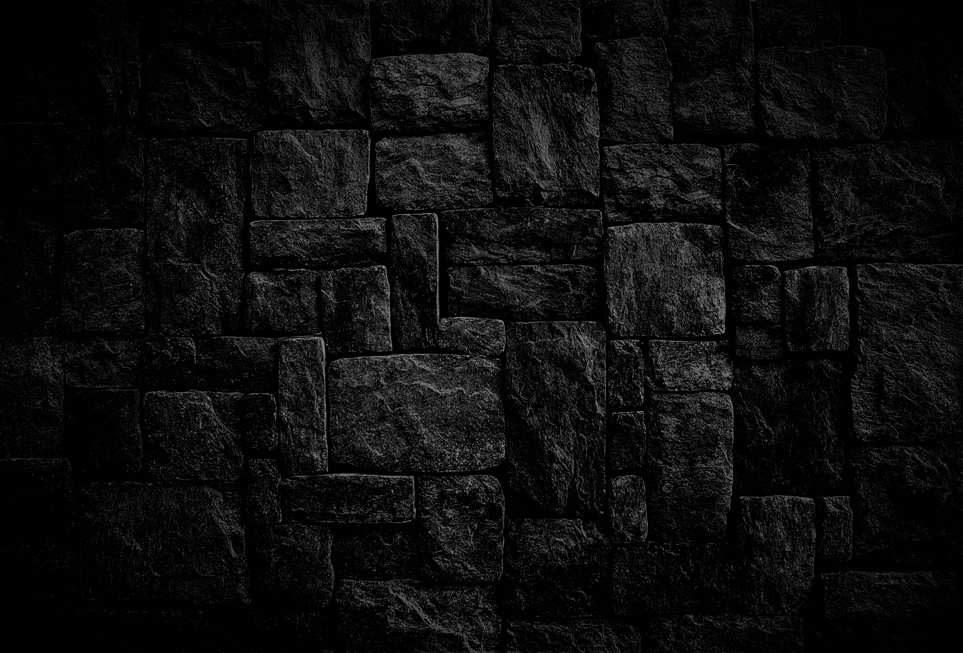
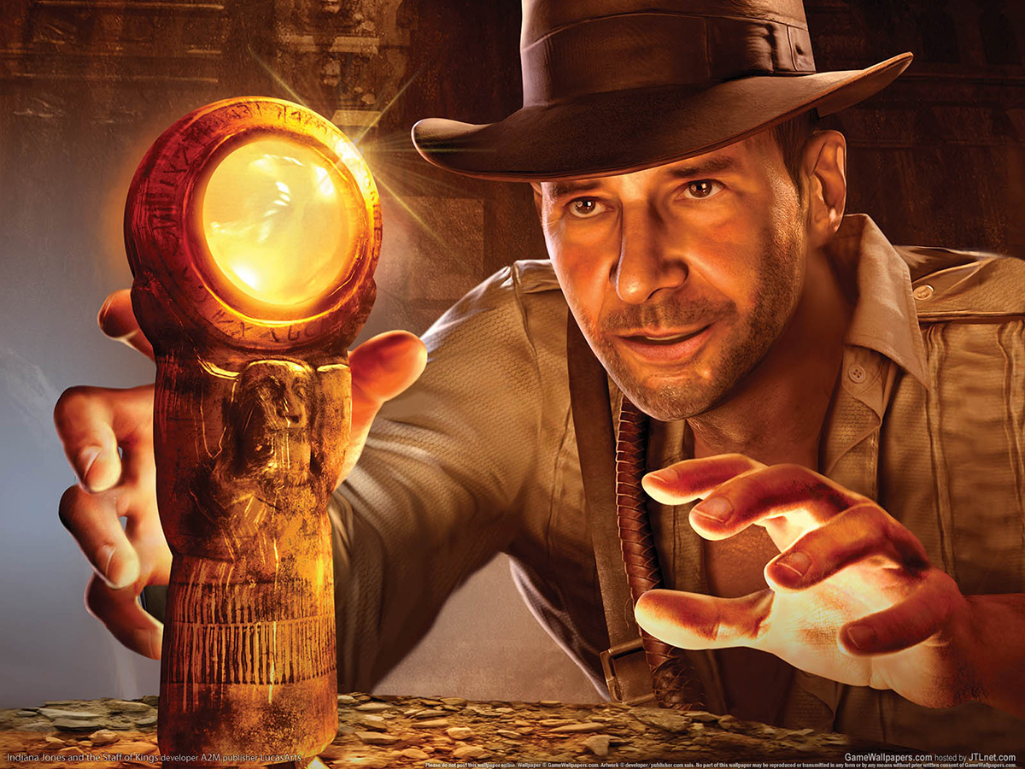
Temple Runner
CSCI 166 – Project Report
Zachary Scott, Caleb Tenney, and Kristen Labrie

Slide 2
Part 1 - Domain
The temple is a maze with an entrance, dirt floors, traps, walls, and an exit.
Agent begins at the entrance, must survive, and proceed to exit.
Agent has already acquired treasure and must navigate to the exit.
Running through the maze is the safest option, but can exhaust the agent.
An exhausted agent is forced to take riskier actions.

Slide 3
Part 2 – Problem Representation
The Agent takes actions in a {Cadence, Direction} pair.
The Agent can WALK, RUN, or SNEAK.
The Directions are NORTH, SOUTH, EAST, and WEST.
Reward of 100 given if the player reaches the Exit Door.
Transition Model

Slide 4
Part 3 - MDP
Value Iteration explores all (Direction, Cadence) pairs of each state, and finds the best value.
Extracts the best policy of each state by examining surrounding states values, and choosing the best value.

Slide 5
Part 4 – Reinforcement Learning
Did not manage to program Q-Learning or Approximate Q-Learning into this domain.
Framework is in place, could be completed given more time.

Slide 6
Demo Time!

Slide 7
Part 5 - Results
Value Iteration works great for this model.
Clearly displays the routes that are risky because of the low chances to survive in the Transition function.
Policy Extraction paints a clear picture of which route to take, can be fine-tuned by changing the discount.

Slide 8

Questions?
CSCI 166 – Project Report
Zachary Scott, Caleb Tenney, and Kristen Labrie

